Slide 1
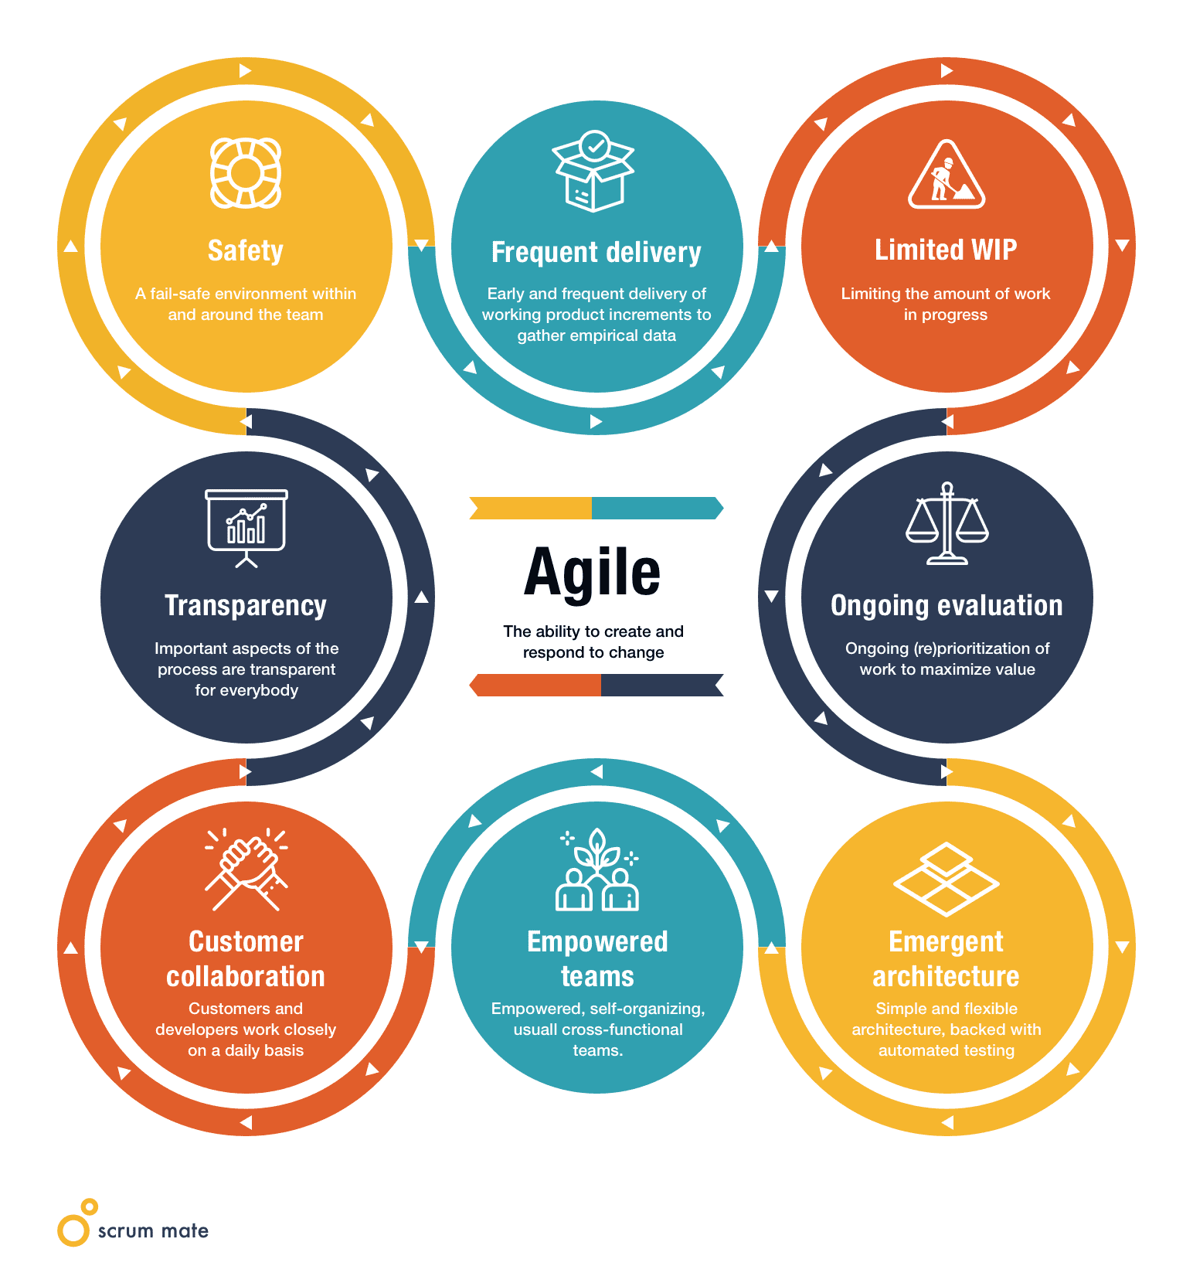
Principles and values of Agile
Agile development focuses on customer satisfaction, embracing change, and delivering working software regularly through collaboration and technical excellence.

Slide 2
Values
Individuals and Interactions : Focus on people and teamwork rather than rigid processes or tools.
Working Software : Prioritize delivering functional software over excessive documentation.
Customer Collaboration : Engage closely with customers to meet their needs, instead of sticking to contract terms.
Responding to Change : Adapt to changes flexibly rather than following a fixed plan.
These values emphasize adaptability, collaboration, and delivering real results.

Slide 3
Principles
Customer Satisfaction : Prioritize customer satisfaction through early, continuous software delivery.
Embrace Change : Adapt to changing requirements, even late in development.
Frequent Delivery : Deliver working software regularly, with a preference for shorter cycles.
Collaboration : Ensure business and development teams collaborate daily.
Empowered Teams : Build projects around motivated individuals; provide support and trust.
Face-to-Face Communication : Prioritize direct communication for efficiency.
Measure Progress : Working software is the main indicator of progress
Sustainable Pace : Maintain a consistent pace of development.
Technical Excellence : Focus on technical quality and good design.
Simplicity : Maximize efficiency by minimizing unnecessary work.
Self-Organizing Teams : Encourage teams to design solutions independently.
Continuous Improvement : Regularly reflect and adjust to improve effectiveness.

